Slide 1

Guardian
Powered By

Slide 2
Cybersecurity + AI
Challenge | What We Did | Business Outcome
Organizations generate vast amounts of data today, yet they only use a fraction of that data to secure their enterprises. The challenge is to make this corpus of information more accessible to reduce cybersecurity risk. | We built a model to estimate risk for each API call in the dataset using network traffic data (“BETH” from Kaggle), CVE (NVD), and synthetic data to connect them. Then, we used Databricks to analyze key data attributes passed to the API using an isolation forest model to estimate anomalous activity and identify a potential attack. | From this information, we can identify network API data calls that look like a potential attack, along with an estimated probability that it is an attack. In the future, this data can be joined with vulnerability scan data, high value assets (HVAs), and other factors to view

Slide 3
Metrics at a glance
 | Subset | Rows
Training | 67% | 763K
Validation | 16.5% | 188K
Testing | 16.5% | 188K
 | F1 Score | Precision | Recall
Validation | 62.9% | 99% | 46%
Testing | 84.3% | 88.5% | 86.5%

Slide 4
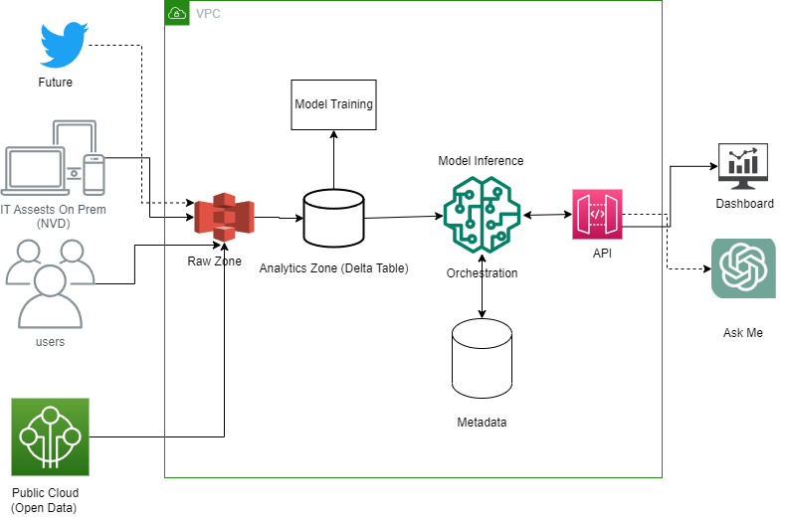
High Level Architecture

Slide 5
